Slide 1
YOUR
BUSINESS is the world,
SIMEST is by your side.

Slide 2






Who we are
SIMEST is part of «Cassa Depositi e Prestiti Group» (CDP). CDP is a company fully owned by the Italian Ministry of Economy and Finance. SIMEST’s core business is to support the internationalization of Italian companies
Shareholders
24%
Banks and associations
Acting as manager of public funds on behalf of the Italian Ministry of Foreign Affairs and International Cooperation, SIMEST is the Italian entity entitled to provide financial support to the export and internationalization process of Italian companies. The Ministry’s competencies in commercial policy and internationalization of Italian business and trade include the supervision of SIMEST and the Italian Trade Agency (ITA)
76%
CDP
As member of the EDFI network - European Development Financial Institutions, SIMEST is a strategic partner for the main global financial institutions

Slide 3






Range of instruments
We operate through financing for internationalization, in support of export credit and equity loans
Equity Loans
for the establishment of Italian companies abroad with the support of an institutional partner
Public Equity Funds
for the growth of SMEs on foreign markets and for international infrastructure projects
Soft Loans for Internationalization
for investments in digitalization, sustainability, skills development and growth on foreign markets
Export Credit Support
to improve the competitiveness of Italian export by reducing financial costs
We accompany Italian companies throughout the internationalization cycle, starting from the first assessment aimed at entering new markets, to expansion through direct investments.
  Strategic support from our foreign offices
  to facilitate the entry and consolidation in priority markets for Made in Italy

Slide 4

Key figures 2025
461 €/mln
1.068€/mln
mobilised resources*
2.494 operations
EQUITY LOANS
SOFT LOANS FOR INTERNATIONALIZATION
7.152 €/mln
106 operations
EXPORT CREDIT SUPPORT
* including Venture Capital, interest-rate subsidies, start up and Plafond Growth resources

Slide 5





Projects in portfolio 2025
~30 billions managed
~49 billions including Buyer Credit commitments
124
COUNTRIES
EUROPE & CIS
Equity Loans : 432 €/mln
Soft Loans : 2.814 €/mln
Export Credit Support : 5.591 €/mln
ASIA
Equity Loans : 109 €/mln
Soft Loans : 27 €/mln
Export Credit Support : 103 €/mln
NORTH AMERICA
Equity Loans : 236 €/mln
Soft Loans : 87 €/mln
Export Credit Support: 1.331 €/mln
232
EQUITY LOANS
AFRICA & MIDDLE EAST
Equity Loans : 65 €/mln
Soft Loans: 38 €/mln
Export Credit Support : 9.000 €/mln
OCEANIA
Equity Loans: 6 €/mln
Soft Loans : 2 €/mln
Export Credit Support : 2 €/mln
LATIN AMERICA
& CARIBBEAN
Equity Loans : 121 €/mln
Soft Loans: 13 €/mln
Supporto export: 10.139 €/mln
15.440
SUPPORTED COMPANIES

Slide 6
FOCUS:
EQUITY LOANS

Slide 7








Equity Loans
We promote the establishment of Italian companies abroad, both on EU and non-EU markets, guaranteeing medium/long-term financial support for the investment project
1. SIMEST Equity Loan
with possible shareholder financing
Acquisition of a stake in the capital of the foreign company through SIMEST own funds and with a time horizon up to 6-8 years with a buy back agreement with the Italian partner. Predetermined exit price
Max 49%
of the share capital of the investment vehicle
2. VC* Equity Loan
with possible shareholder financing
Additional participation of the Venture Capital resources managed by SIMEST at promotional economic conditions and in line with the structure of the SIMEST investment. The VC resources can also support the internationalization processes of Innovative start-ups and SMEs
Interest subsidy*
Interest subsidy on bank or other intermediaries’ loans (including CDP), obtained by the Italian company for the acquisition of its stake in the foreign company (non-EU)
BENEFITS
Institutional partner
Light
governance
Fixed
return
Tailor-made
structure
* Resources from public funds managed by SIMEST on behalf of MAECI

Slide 8





Equity Loans – General Overview
    ITALIAN
    COMPANY
    PARTNER
51%
CAPITAL AMOUNT
FOREIGN
TARGET
COMPANY
49% MAX
CAPITAL AMOUNT
EQUITY
SIMEST
+
VENTURE CAPITAL AMOUNT
Rate BCE + 0,5% (Small), 0,75% (Medium), 1% (Large)
Equity Loan
Non-EU
Investiment:
Interest grants
(December 2025 equal to ~2%)
BANK
Facilitation on bank financing for the subscription of the Italian company's stake in the foreign company (max 90% of the stake held by the Italian company, with a limit of 51% of the total capital)
Interest grants on EQUITY LOAN

Slide 9
FOCUS:
PUBLIC EQUITY FUNDS

Slide 10



New Public Equity Funds for Growth and Infrastructure
Minority intervention in the share capital of target companies within the scope of new sections of the 394 Fund
GROWTH PLAFOND
INFRASTRUCTURE PLAFOND
100 €mln for capital strengthening
of Italian companies
100 €mln for infrastructure projects in strategic geographies
Dedicated to SMEs and Mid Cap companies
Long-term support
Co-investment with leading financial operators
International growth of Made in Italy
Enabler of public and private investiments
Structured involvement of Italian supply chains
Active from 2023, 200 €mln Plafond to support the internationalization process of Start up e Innovative SMEs, through direct and indirect investments (FOFINT)
Public resources managed by SIMEST on behalf of the MAECI

Slide 11
FOCUS:
SOFT LOANS FOR INTERNATIONALIZATION

Slide 12











Soft loans for internationalization
New soft loans for internationalization*: we support international competitiveness of Italian companies.
Focus areas: digitalization, sustainability, growth in foreign markets, skills development, and supply chains.
Solutions for investments
Solution for skills development
Solutions for international growth
AFRICAN MARKETS DEVELOPMENT
COMPETITIVITÀ
AMERICA LATINA
NEW
GREEN AND DIGITAL TRANSITION
LATIN AMERICA COMPETITIVENESS
SUPPORT FOR THE INDIAN MARKET
CERTIFICATIONS AND CONSULTANCY
TEMPORARY MANAGER
PROGRAMS FOR ENTERING FOREIGN MARKETS
TRADE FAIRS
AND
EXHIBITION
E-COMMERCE
Dedicated conditions for energy-intensive companies
Subsidized rate
~0,3%
Non-repayable quota 10%
Up to 6 years
Up to
5 €mln
25% in advance
Digitalized onboarding
BENEFITS
choice based on
de minims capacity
financing duration
maximum amounts by financial instrument
further disbursements based on final report
simest.it
Southern Italy SMEs, youth SMEs, female SMEs, sustainability, strategic markets
(Western Balcans, Africa, Latin America, India, USA)
NEW
Specific features for Africa, Latin America, India and USA dedicated plafond financing and non-repayable fund, up to 20% for companies located in the South of Italy, start up and innovative SMEs**
Dedicated measures for extraordinary events
for companies affected by exceptional weather events and for energy intensive companies or those that undertaken energy efficiency programs
*Resources from public funds managed by SIMEST on behalf of MAECI
**for Africa, Latin America and India

Slide 13



Soft Loans - Focus «USA Measure»
Soft loans* at 0,3%
for international competitiveness
Tailored conditions for financing US subsidiaries, investments or driving local commercial growth
CERTIFICATIONS AND CONSULTANCY
TEMPORARY MANAGER
TRADE FAIRS
AND
EXHIBITION
200 €mln
dedicated reserve
10%
non-repayable quota
First tranche of funding to
50%
GREEN AND DIGITAL TRANSITION
PROGRAMS FOR ENTERING FOREIGN MARKETS
E-COMMERCE
Extendable duration up 8 years
Preamortization unchanged
Green and Digital Transition
Entering new foreign markets
Capital strengthening up to 80%
Green and Digital Transition
Capital increases & shareholder loans up to 1 €mln for US subsidiaries
Green and Digital Transition
BENEFICIARY COMPANIES
  Exporting companies that export, import or have a steady presence in the USA
  For companies that intend to
  invest locally
  Companies applying to finance business projects focusing on the USA
  Entering new foreign markets, Certifications and Consultancy,
  Trade fairs and Exhibition, E-commerce, Temporary Manager
Green and Digital Transition
Green and Digital Transition
Additional support provided for direct investments through Equity Loans and Equity for start-ups and innovative SMEs
13
13
*Resources from public funds managed by SIMEST on behalf of MAECI

Slide 14
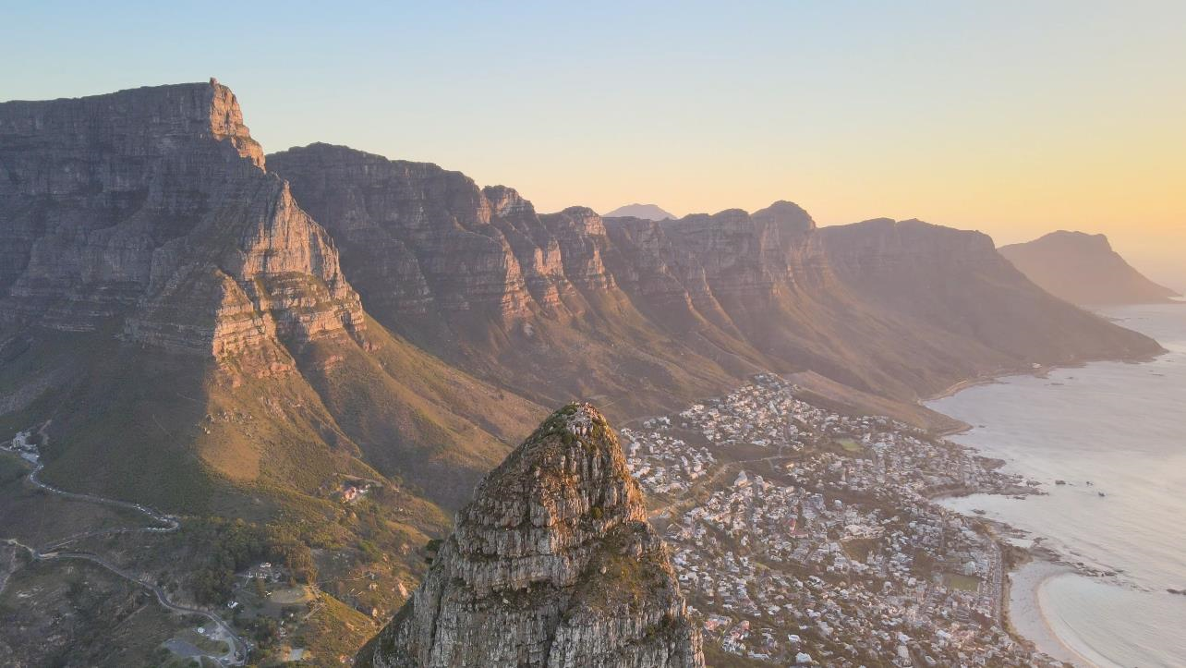


Soft Loans - Focus «Africa Measure»
DEDICATED CONDITIONS
TO FINANCE
A new reserve dedicated to the new measure launched in July 2024: 200 €mln
TRAINING FOR AFRICAN EMPLOYEES
Including dedicated facilites, travel, accomodation, immigration, work permits and work contract for trained personel
10% non-repayable quota, up to 20% for Southern Italy companies, start-ups and innovative SMEs
No guarantees required
Sub-fund for young, female entrepreneurs and innovative SMEs/start-ups
INNOVATION AND KNOW-HOW TRANSFER
Productive and commercial investments in Italy and Africa and financing of subisidiary companies
COMPETITIVENESS
Sustainability and digitalization, specialized consulting services, advisory and certifications, scouting and matchmaking, trade fairs focused on Africa
BENEFICIARY COMPANIES
  del finanziamento destinato alla copertura di investimenti per il rafforzamento patrimoniale
  For non-exporting companies that intend to invest locally
  Exporting companies that export, import or have a steady presence in Africa, even through supply chain
  Companies applying to finance business projects focusing on Africa
  Entering new foreign markets, Certifications and Consultancy,
  Trade fairs and Exhibition, E-commerce, Temporary Manager
14

Slide 15
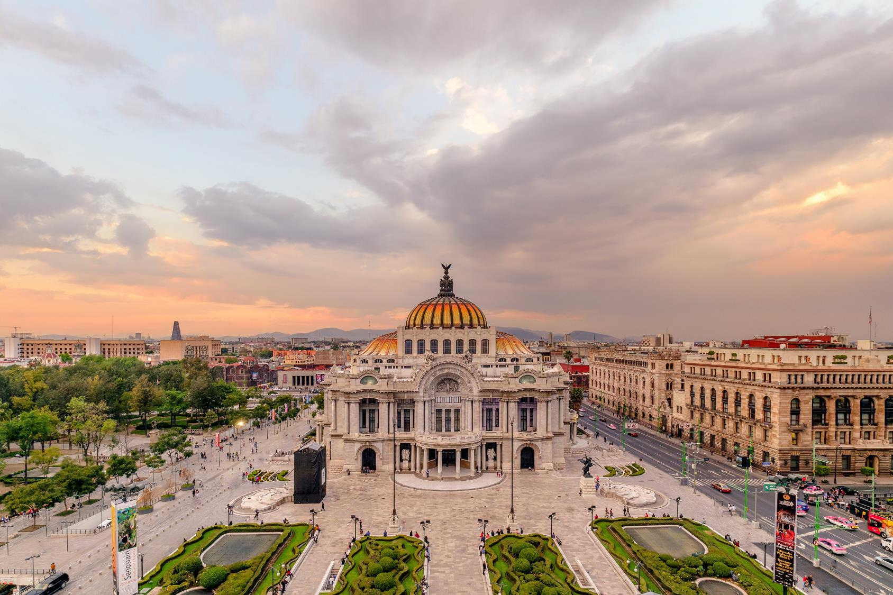
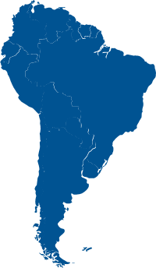

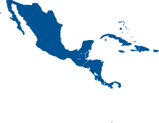
Soft Loans - Focus «Latin America Measure»
DEDICATED CONDITIONS
GEOGRAPHIES
A new reserve dedicated to the new measure launched in March 2025: 200 €mln
MEXICO
CENTRAL AMERICA
SOUTH AMERICA
10% non-repayable quota, up to 20% for Southern Italy companies, start-ups and innovative SMEs
No guarantees required
Funding for digitalization and sustainability, capital strengthening, training and identification of new business opportunities
BENEFICIARY COMPANIES
  del finanziamento destinato alla copertura di investimenti per il rafforzamento patrimoniale
  For non-exporting companies that intend to invest locally
  Exporting companies that export, import or have a steady presence in Latin America, even through supply chain
  Companies applying by 31.12.2026 to finance business projects focusing on Latin America
  Entering new foreign markets, Certifications and Consultancy,
  Trade fairs and Exhibition, E-commerce, Temporary Manager
15

Slide 16

Soft Loans - Focus «India Measure»
DEDICATED CONDITIONS
TO FINANCE
A new reserve dedicated to the new measure launched in September 2025: 200 €mln
INVESTMENTS IN PRODUCTION AND COMMERCIAL DEVELOPMENT
10% non-repayable quota
20% non-repayable quota for Southern Italy companies, start-ups and innovative SMEs
New eligible expenses for the identification of business opportunities
INNOVATION AND SUSTAINABILITY
STAFF TRAINING
SPECIALIZED MARKET CONSULTING
SCOUTING E MATCHMAKING
BENEFICIARY COMPANIES
  del finanziamento destinato alla copertura di investimenti per il rafforzamento patrimoniale
  For non-exporting companies that intend to invest locally
  Exporting companies that export, import or have a steady presence in India, even through supply chain
  Companies applying to finance business projects focusing on India
  Entering new foreign markets, Certifications and Consultancy,
  Trade fairs and Exhibition, E-commerce, Temporary Manager
16

Slide 17

Soft Loans - Focus «Measure for energy-intensive companies »
Capital support to alleviate the impact of energy costs.
DEDICATED CONDITIONS
The “Green and Digital Transition" targets energy-intensive exporting companies or those that have undertaken certified energy efficiency pathways (including those in the process of obtaining an energy audit), with new eligible expenses and dedicated conditions:
20% non-repayable quota
No guarantees required
Up to 90% of the Green and Digital Transition funding can be allocated to expenses for capital strengthening, with the possibility of increasing share capital and providing shareholder loans to subsidiary companies.

Slide 18
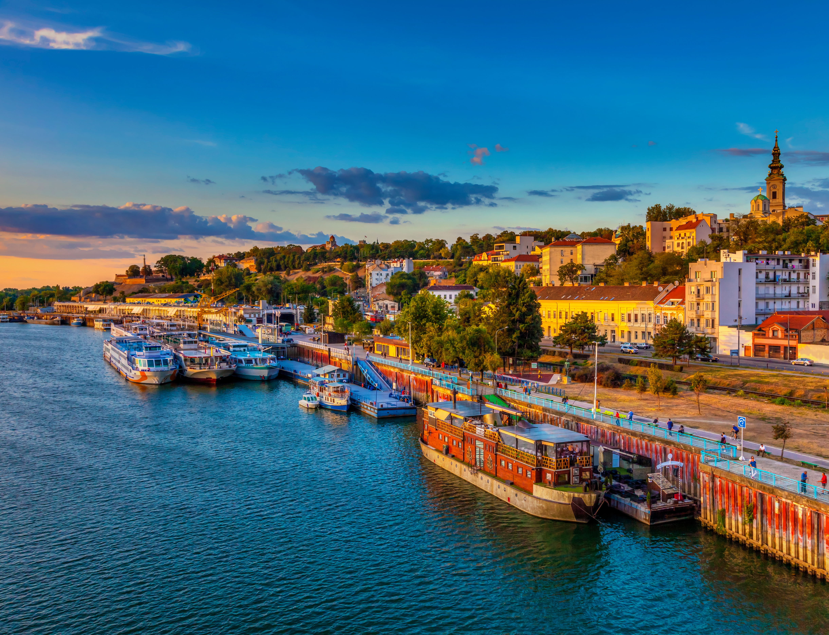






Soft Loans - Focus «Balkans Measure»
DEDICATED CONDITIONS
TARGET COUNTRIES
Dedicated reserve: 200 €mln for all financing lines renewed in July 2024 with an additional €200 million.
10% non-repayable quota
No guarantees required
Up to 80% of the “Green and Digital Transition” funding can be allocated to expenses for capital strengthening.
SERBIA
KOSOVO
MONTENEGRO
NORTH MACEDONIA
BOSNIA - HERZEGOVINA
ALBANIA
BENEFICIARY COMPANIES
  del finanziamento destinato alla copertura di investimenti per il rafforzamento patrimoniale
Direct Interest
Exporters to/importers from the Western Balkans
Presence in the Western Balkans
With a commercial, manufacturing, or representative office.
With a production supply chain
A company that is a supplier to Italian companies operating in the Western Balkans.
Programs For Entering Foreign Markets
A company requesting “Programs For Entering Foreign Markets” funding in the Western Balkans.

Slide 19
FOCUS:
EXPORT CREDIT

Slide 20





Export Credit Support
SIMEST, as manager of public funds on behalf of the Italian Ministry of Foreign Affairs and International Cooperation, provides supports to Italian companies through an interest rate contribution on medium - long term export credit financings, structured as:
BUYER CREDIT FINANCINGS
SUPPLIER CREDIT FINANCINGS
NEW
Digitalized onboarding
SIMEST provides a “stabilization of the interest rate” of the financing at a subsidized fixed rate (so called CIRR quoted monthly by OECD) in addition to a fixed non-refundable subsidy on the margin required by the financing bank (including CDP) to the foreign buyer of Italian good and services
SIMEST provides a fixed non-repayable interest rate subsidy to cover (partially or totally) the discount rate required by the discounting entity for the monetization promissory notes /bonds/ letter of credit issued by the foreign buyer of Italian goods and services.
The Buyer Credit interest rate support can also be activated on «Letter of Credit» with post-financing
The Supplier Credit interest rate contribution can also be activated under «Export lease contracts»
Supplier Credit Financing: eligibility of commercial invoices and contributions of
up to 5% for export contracts

Slide 21
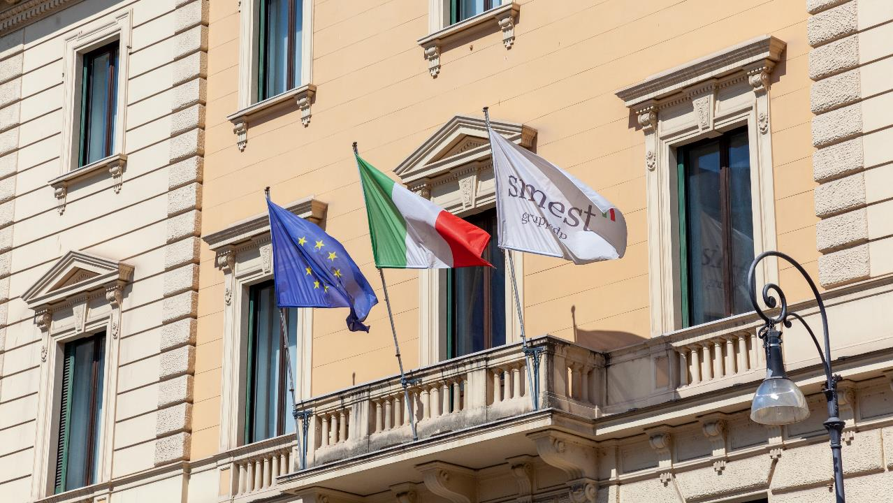
Thank you

